Slide 1
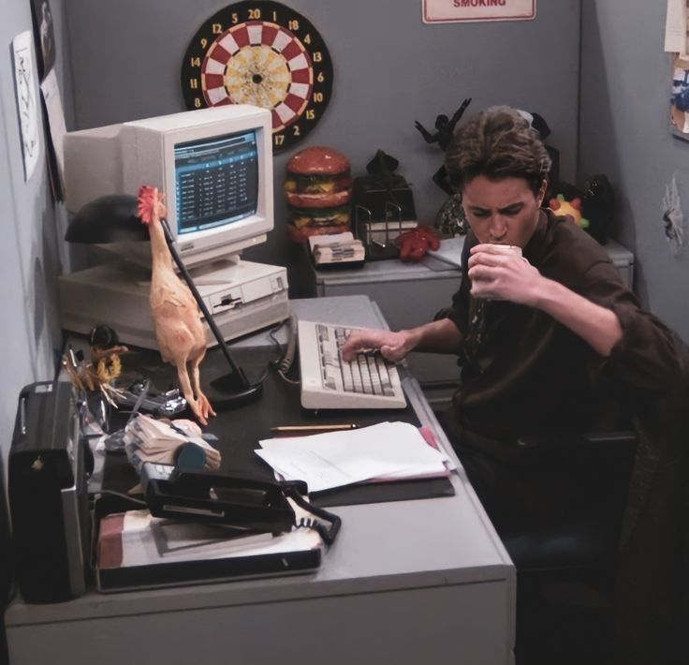
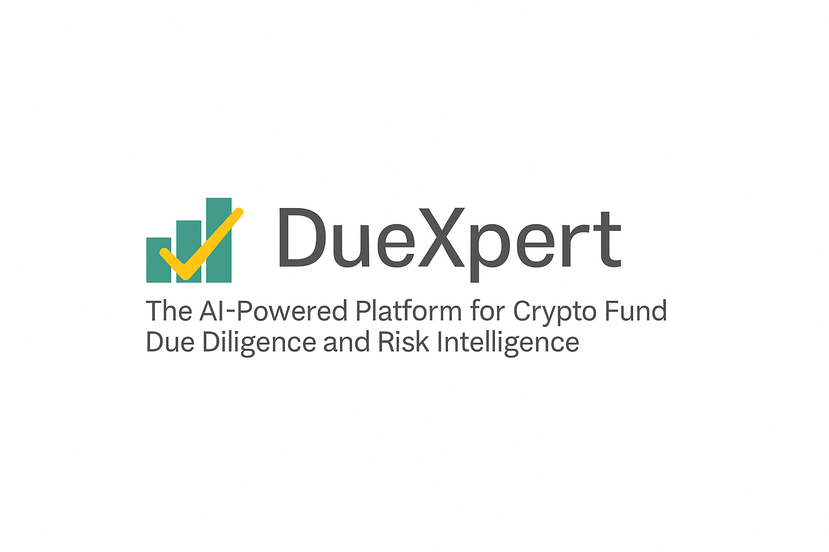
Due Diligence Report
Prepared by DueXpert | 2025-04-24
DueXpert – AI Crypto Fund Due Diligence Suite | info@duexpert.ai | www.duexpert.ai

Slide 2
CONTENTS
1 AML / KYC
3
2 COMMUNITY & UX
4
3 CUSTODY & ASSET SECURITY
5
4 CYBERSECURITY & DATA PRIVACY
6
5 ESG & SUSTAINABILITY
7
6 FINANCIAL HEALTH
8
7 GOVERNANCE
9
8 IP & CONTRACTS
10
9 LEGAL & REGULATORY
11
10 RISK MANAGEMENT
12
11 STRATEGY & COMPETITIVE POSITIONING
13
12 TECHNOLOGY & INFRASTRUCTURE
14
13 TOKENOMICS & TRADING INTEGRITY
15
DueXpert – AI Crypto Fund Due Diligence Suite | info@duexpert.ai | www.duexpert.ai

Slide 3
3. AML / KYC
Objective: Ensure the company has robust Anti-Money Laundering (AML) and Know Your Customer (KYC) policies and compliance in place.
Key Findings:
- The provided text does not mention specific Anti-Money Laundering (AML) policies and procedures.
Outstanding Issues:
DueXpert – AI Crypto Fund Due Diligence Suite | info@duexpert.ai | www.duexpert.ai

Slide 4
4. Community & UX
Objective: Assess user engagement, platform usability, and transparency of communication with the community.
Key Findings:
- There is no mention of a codebase being open-source or proprietary in the provided text.
- The document does not provide an in-depth evaluation of the user-friendliness of the CryptoBazar Fund's platform.
- There is no mention of a specific customer feedback mechanism in the provided text.
Outstanding Issues:
- Insufficient detail on - how active is the community around the project?
DueXpert – AI Crypto Fund Due Diligence Suite | info@duexpert.ai | www.duexpert.ai

Slide 5
5. Custody & Asset Security
Objective: Evaluate how the company stores and secures digital assets and whether custody mechanisms are robust.
Key Findings:
- The document doesn't explicitly mention how digital assets are stored and secured.
- The provided text, the following procedures for buying and selling digital assets can be inferred: **Buying Digital Assets:** 1.
- The document, digital assets are valued in two ways: 1.
Outstanding Issues:
- Insufficient detail on are multi-signature wallets used for custody?
- Insufficient detail on what measures are in place to verify asset ownership?
- Insufficient detail on - does the company have insurance coverage for digital assets?
DueXpert – AI Crypto Fund Due Diligence Suite | info@duexpert.ai | www.duexpert.ai

Slide 6
6. Cybersecurity & Data Privacy
Objective: Examine the strength of cybersecurity practices and safeguards for user and company data.
Key Findings:
- There is no mention of how the company handles user data privacy in the provided text.
- There is no mention of a specific data protection policy in the provided text.
- There is no mention of penetration testing in the provided text.
Outstanding Issues:
- Insufficient detail on - what blockchain technology is used, and how secure is it?
- Insufficient detail on - what cybersecurity measures are in place to protect against hacks?
- Insufficient detail on are two-factor authentication and end-to-end encryption used?
DueXpert – AI Crypto Fund Due Diligence Suite | info@duexpert.ai | www.duexpert.ai

Slide 7
7. ESG & Sustainability
Objective: Evaluate the company’s environmental, social, and governance practices and long-term sustainability impact.
Key Findings:
- Based on the provided document, it appears that the revenue diversification is not explicitly discussed.
- There is no mention of initiatives to reduce energy consumption in the provided text.
- There is no mention of sustainability practices or policies in the provided text.
Outstanding Issues:
- Insufficient detail on are there any initiatives to reduce this footprint?
- Insufficient detail on how does the company promote sustainability within its ecosystem?
DueXpert – AI Crypto Fund Due Diligence Suite | info@duexpert.ai | www.duexpert.ai

Slide 8
8. Financial Health
Objective: Ensure the company’s financial statements, cash flows, and projections reflect a healthy financial position.
Key Findings:
- Based on the provided text, there is no specific mention of "disputes" that could lead to potential financial exposures.
- The answer is not explicitly mentioned in the provided text.
- The document provided does not contain comprehensive financial information about the company's financial health.
Outstanding Issues:
- Insufficient detail on are there any cash flow projections available?
DueXpert – AI Crypto Fund Due Diligence Suite | info@duexpert.ai | www.duexpert.ai

Slide 9
9. Governance
Objective: Assess decision-making structure, roles of stakeholders, and board oversight processes.
Key Findings:
- After analyzing the provided text, I did not find any explicit mentions of potential conflicts of interest among stakeholders.
- Yes, according to the text, there is information about the following people involved in the Cryptobazar Fund: * Managing Partners: They are responsible for carrying out deals and transactions with assets, and making decisions on behalf of the co-investors. * Co-investors (also referred to as investors): These are individuals who have invested in the fund and share in its risks and potential returns. However, there is no mention of "developers" being specifically engaged.
- Based on the provided document, it appears that the governance structure of the Cryptobazar Fund is as follows: * **Managing Partners**: They are responsible for carrying out deals and transactions with assets without the instruction or consent of co-investors.
Outstanding Issues:
- Insufficient detail on - what are the details of past funding rounds?
- Potential weakness: are these reports audited by external firms?
DueXpert – AI Crypto Fund Due Diligence Suite | info@duexpert.ai | www.duexpert.ai

Slide 10
10. IP & Contracts
Objective: Evaluate the clarity of intellectual property (IP) ownership and the contractual integrity of the business.
Key Findings:
- Based on the provided text, there is no information about the company owning any Intellectual Property (IP) assets.
- After reviewing the provided text, I did not find any specific information about intellectual property (IP) infringement issues.
- There is no mention of IP (Intellectual Property) rights in the provided text.
Outstanding Issues:
- Insufficient detail on - how does the company handle disputes with customers or partners?
DueXpert – AI Crypto Fund Due Diligence Suite | info@duexpert.ai | www.duexpert.ai

Slide 11
11. Legal & Regulatory
Objective: Ensure the company’s legal entity, licensing, and jurisdictional compliance are clearly established.
Key Findings:
- The provided document, the CryptoBazar Fund is a venture fund that invests in blockchain technology and cryptocurrencies.
- After reviewing the provided text, I did not find any information about significant changes in the legal structure of CryptoBazar Fund over time.
- There is no explicit mention of whether all necessary licenses and permits are in place.
Outstanding Issues:
- Insufficient detail on - what are the tax obligations of the company in different jurisdictions?
- Potential weakness: - Have all necessary regulatory approvals been obtained?
DueXpert – AI Crypto Fund Due Diligence Suite | info@duexpert.ai | www.duexpert.ai

Slide 12
12. Risk Management
Objective: Identify how the company manages internal and external risks, including business continuity.
Key Findings:
- There is no mention of "conflicts" in the provided text.
- Yes, according to the Risk Warning Notice, there is a mention of "actions of state bodies or trading platforms that regulate Russian and international securities market" as one of the risks that co-investors assume.
- A thorough review! Based on the provided document, here are some potential concerns and questions: 1.
Outstanding Issues:
- Insufficient detail on - is there a business continuity plan in place for unexpected disruptions?
- Insufficient detail on - what training programs are in place for employees handling sensitive operations?
DueXpert – AI Crypto Fund Due Diligence Suite | info@duexpert.ai | www.duexpert.ai

Slide 13
13. Strategy & Competitive Positioning
Objective: Understand the company’s business model, growth strategy, and differentiation in the market.
Key Findings:
- After carefully reviewing the document, I've identified some potential pain points and areas for improvement: 1.
- The text, the company, CryptoBazar Fund, has a strong market position in the cryptocurrency and blockchain technology investment space.
- The document doesn't explicitly mention specific competitors or market gaps, but it does provide some information that can be inferred: * The CryptoBazar Fund is positioning itself as an alternative to other ICO investment options by entering projects before they launch their ICOs. * The fund's strategy of investing in pre-ICO stages and providing preferential exit rights may be a differentiator from other funds or investors. * The market for cryptocurrency and blockchain investments is growing, but it is still relatively small compared to traditional financial markets.
Outstanding Issues:
- Insufficient detail on what are their backgrounds and expertise?
DueXpert – AI Crypto Fund Due Diligence Suite | info@duexpert.ai | www.duexpert.ai

Slide 14
14. Technology & Infrastructure
Objective: Evaluate the scalability, reliability, and modernity of the company’s technological backbone.
Key Findings:
- Based on the provided text, it appears that there is no explicit information about the primary funding sources for the Cryptobazar Fund.
- The provided text, yes, there are plans for future scalability and growth.
- No, there is no mention of energy-intensive mining methods in the provided text.
Outstanding Issues:
- Insufficient detail on - what measures are in place to secure the company's infrastructure?
- Insufficient detail on are there plans for upgrading infrastructure to meet growing demand?
DueXpert – AI Crypto Fund Due Diligence Suite | info@duexpert.ai | www.duexpert.ai

Slide 15
15. Tokenomics & Trading Integrity
Objective: Assess token issuance mechanisms, market manipulation controls, and valuation transparency.
Key Findings:
- Based on the provided documentation, it appears that the CryptoBazar Fund has not explicitly stated its compliance with relevant securities and commodities laws.
- There is no mention in the provided text of specific trade surveillance mechanisms to prevent market manipulation.
- The text does not explicitly state whether valuations are consistent with market standards.
Outstanding Issues:
- Insufficient detail on how does the company ensure compliance with these standards?
DueXpert – AI Crypto Fund Due Diligence Suite | info@duexpert.ai | www.duexpert.ai

